Slide 1
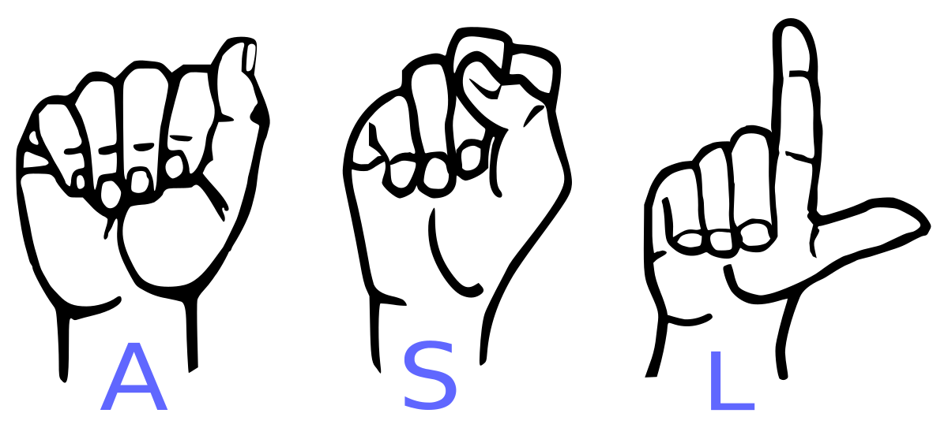
American Sign Language Translator
Computer Vision Project Spring 2021

Slide 2

Problem Statement
Luke Flaherty

Slide 3
What is our Application
Our application was proposed as a way of translating hand gestures into text so people who use sign language can communicate with the everyone without the need of an interpreter or writing everything down.
There is no application on the market that solves this problem; there are some projects which translate recorded video, but nothing in real time.
Due to the scope of the idea, we first focused on just translating static images for ASL fingerspelling.

Slide 4
Why is our application important?
For far too long our society has favored spoken language to the detriment of all else.
It is not fair to the non-able communities who have had barriers put up, limiting their ability to communicate. The modern workplace values diverse opinions and views and we are ignoring a whole demographic without having an easy way to incorporate the deaf and mute communities.
Research in this area could provide better life outcomes for those who have been traditionally isolated by society for something that is out of their control.

Slide 5

Methodology
Alaa Alharthi

Slide 6
Relevant Research
Research of a Sign Language Translation System Based on Deep Learning (Author:Siming He)
Real-Time American Sign Language Recognition with Faster Regional Convolutional Neural Networks (Authors​​: S. Dinesh, S. Sivaprakash, M. Keshav, K. Ramya et al.)
A survey on Sign Language Recognition Using Smartphones (Authors:​ Sakher Ghanem , Christopher Conly, Vassilis Athitsos, et al.)
Translation of Sign Language Finger-Spelling to Text using Image Processing (Authors:​ Krishna Modi, Amrita More, et al.)
Notes:
Computer vision appro:
It extracts the image from the video stream, eliminates its
background using RGB filtering and thresholding. Then, it
performs edge detection on the binary image and crops the
hand posture part from it. Then, it resizes the image to a
standard size and then uses error matrix to calculate error
among all the images in the database and the processed
captured image.
Drawback of using traditional CV :
fails in the environment has background with skin colors. ( Hands have to be distinguished from other skin color objects and there are cases of insufficient lighting conditions)

Slide 7
Relevant Research
Traditional Computer vision methods
Deep Learning methods
CNN for hand detection and sign recognition.
Rich feature extraction, strong modeling ability, and intuitive training
Skin color for hand detection.
Template Matching for sign recognition.
Assumption : Hands have to be distinguished from other skin color objects.
Notes:
Computer vision appro:
It extracts the image from the video stream, eliminates its
background using RGB filtering and thresholding. Then, it
performs edge detection on the binary image and crops the
hand posture part from it. Then, it resizes the image to a
standard size and then uses error matrix to calculate error
among all the images in the database and the processed
captured image.
Drawback of using traditional CV :
fails in the environment has background with skin colors. ( Hands have to be distinguished from other skin color objects and there are cases of insufficient lighting conditions)

Slide 8
How we solved it?
The current research attempt to solve the sign languages translation is done using the deep learning approach and it proved that it has many advantages such as rich feature extraction, strong modeling ability, and intuitive training.
Our current model is a Sequential Convolutional Neural Network which will take in an image and predict what character is being signed.

Slide 9
Model
CNN Training Model Architecture
Dropout
MaxPool2D
Convolution2D
(relu)
Convolution2D
(relu)
Input Image
MaxPool2D
Convolution2D
(relu)
Dropout
Dropout
Prediction
Flatten
Dense
(softmax)
Notes:
Input : 64 x 64 RGB image. Output: 38 x 1 probabilities, the highest values correspond to the sign class

Slide 10

Prediction Model Architecture
Input Image
64 x 64 RGB
Final Output
CNN Model
a
Softmax
Output: 38 x1
Notes:
Input : 64 x 64 RGB image. Output: 38 x 1 probabilities, the highest values correspond to the sign class

Slide 11

Results
Luna Lucadou

Slide 12
Result of Training on Static Images
Datasets used:
https://www.kaggle.com/grassknoted/asl-alphabet
Characters: A-Z, delete, and space
Full color images with backgrounds with differing colors
https://www.kaggle.com/ayuraj/asl-dataset
Characters: A-Z, 0-9
Cropped full color images with black backgrounds
https://www.kaggle.com/datamunge/sign-language-mnist
Characters: A-Z
Grayscale images with only slight variations in the background colors

Slide 13
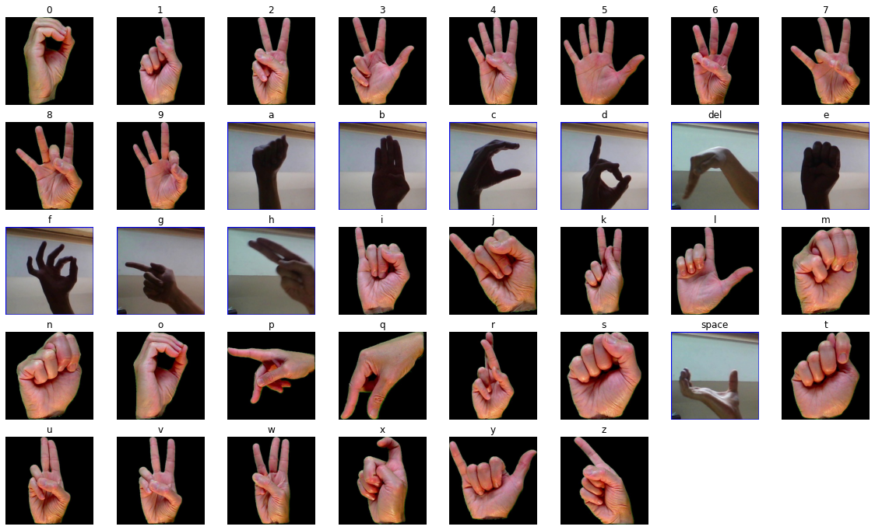
Result of Training on Static Images
Datasets (continued):
96,913 total training images
24,229 total testing images
38 classes (A-Z, 0-9, space, delete)

Slide 14
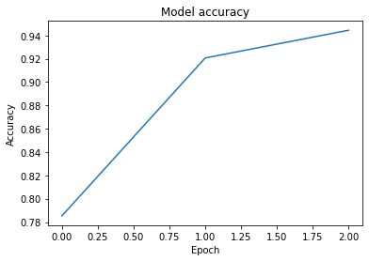
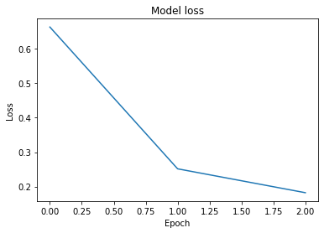
Result of Training on Static Images
Accuracy
First trial with 5 epochs - 80%
Second trial with 3 epochs - 99%
Notes:
When we did our first testing trial after 5 epochs, the model had overfitted and was generalizing poorly
With our second trial with 3 epochs, it generalized much better
You can see the graphs on the right showing the performance of the model

Slide 15
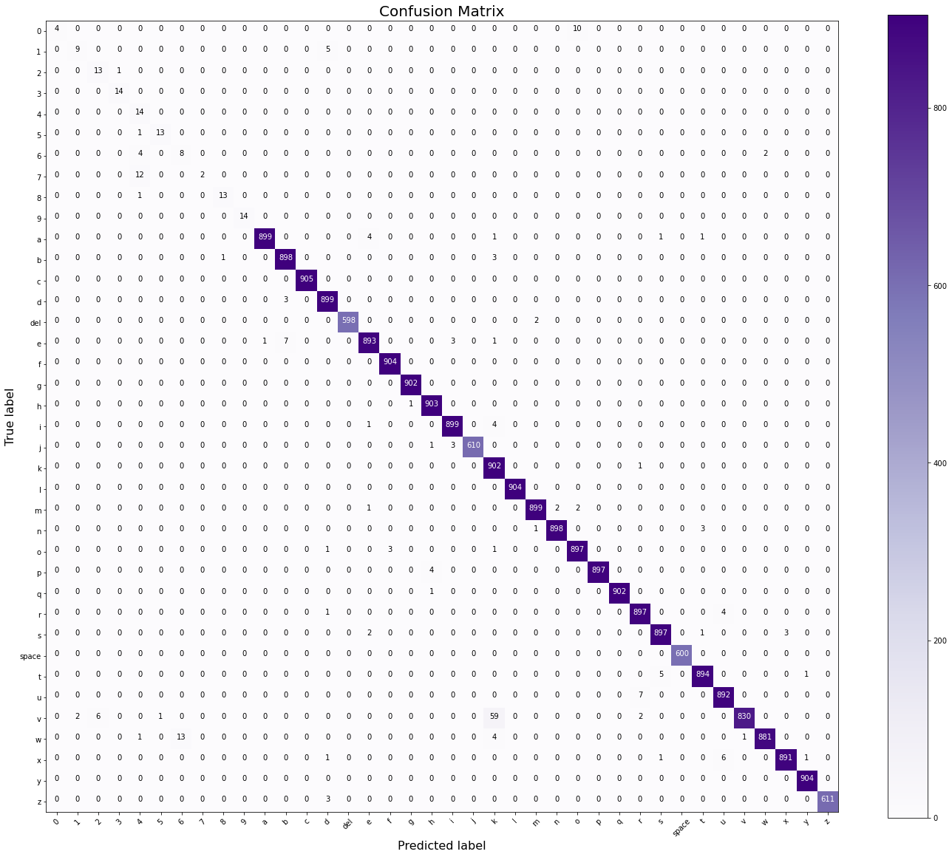
Notes:
This is the confusion matrix. The reason the nice purple-ish line doesn’t go all the way up the diagonal is because that is for 0-9, which had the smallest number of samples since they were only in one dataset, and it was the smallest one. As you might expect, with a lower number of samples, the numbers did not generalize as well. 0, 1, 6, and 7 perform quite poorly; for A-Z, space, and delete, it’s pretty good.

Slide 16























Result of Training on videos
Assumption
This model works decently for static images with differing backgrounds
If we just extract still frames at set intervals, we can apply it to video
Notes:
One thing in the proposal that got modified was a real-time sign language video interpreter. The reason for this is because fingerspelling is the easy problem for sign language interpretation, but it’s also not used all that much because it takes too long.
(Give demonstration of horse jumping over fence)
(Demonstrate context by showing how gestures can be led with specific hands/on specific sides to indicate the subject/object at play)
But if we’re just doing fingerspelling, a fairly logical assumption would be that our model would work well under controlled conditions.

Slide 17
Result of Training on videos
Findings:
31% accuracy
Possible explanations:
Overfitting
Transitional frames
Stylistic choices
Notes:
But when applied to static frames extracted from videos, the accuracy of the model was just 31%.
This model could be very well overfitted to specific backgrounds present in the static image datasets.
Some frames were a bit ambiguous because they were taken during a transition, but 25% of the ones it got right were a bit ambiguous. (However, plenty of the ones it missed were entirely unambiguous, e.g. the letter C - closest letter is D, but still pretty far away, and yet it was mislabeled as N.)
Another thing is that different sign language users have their own styles. These styles are easy to pick up on and account for as humans, but for a computer model, you would probably need a bigger dataset to account for more stylistic choices, and none of the frames from the videos we tried were included in the training data, it was purely a testing scenario. It’s not as pronounced with finger spelling as it would be for gesture-based sign language, but these differences do exist, and it would be necessary to work on better generalizations for real world deployment.
Compare stylistic choices to regional accents: “Fate-vul” and “Fed-vul” for “Fayetteville”, “Boh-fert” NC sharing the same spelling as “Byou-furt” SC
I know that these mean. Well, Boh-fert vs Byou-furt was learned when I mixed the two up, but Cher-vul, Top-sul...I’ve been around enough regional accents that I knew what those were without needing an explanation

Slide 18
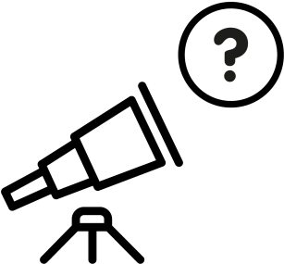
Future Work
Paul O’Meara

Slide 19
What is the future work for this Model
If we had a few more years more knowledge we believe we can improve our model in both performance and accuracy. Other thing we considered for future changes include:
Make the model output words from gestures instead of characters from fingerspelling
Improve hand detection
Ability to scale / resize hand images without losing quality
Reduce overfitting, identify any remaining bugs

Slide 20
Contributions
Alaa Alharthi Luna Lucadou Paul O’Meara Luke Flaherty Avery Brown
Notes:
Luna - research, locating and wrangling datasets, and examining the feasibility of doing video translation
Alaa - research, literature reviews, training and testing the ASL model on statics images and on a video.

Slide 21
Questions ?

Slide 22
Thank You.

